Slide 1

Netflix Data Analysis
Abu Obaida
INTERNSHIP_17546440516895be537820f

Slide 2

PROBLEM STATEMENT
This project aims to analyze Netflix’s content database to study how Movies and TV Shows are distributed across years, genres, and countries. The goal is to identify content trends and provide strategic business recommendations for future content creation and acquisition.

Slide 3
Project Description The dataset contains 7,789 records and 11 columns with information such as Title, Director, Cast, Country, Release Date, Rating, Duration, and Type (Category). The project involves cleaning, exploring, and visualizing data to uncover meaningful patterns like the most common genres, top contributing countries, and evolution of Movies vs. TV Shows on Netflix over time.

Slide 4

WHO ARE THE END USERS?
Netflix’s content strategy and analytics team
Viewers seeking new recommendations
OTT industry researchers
Data scientists focusing on media analytics

Slide 5

Technology Used
Programming Language: Python
Libraries: Pandas, Matplotlib, Seaborn
Environment: Google Colab
Version Control: GitHub Repository
Visualization Tools: Matplotlib & Seaborn plots

Slide 6
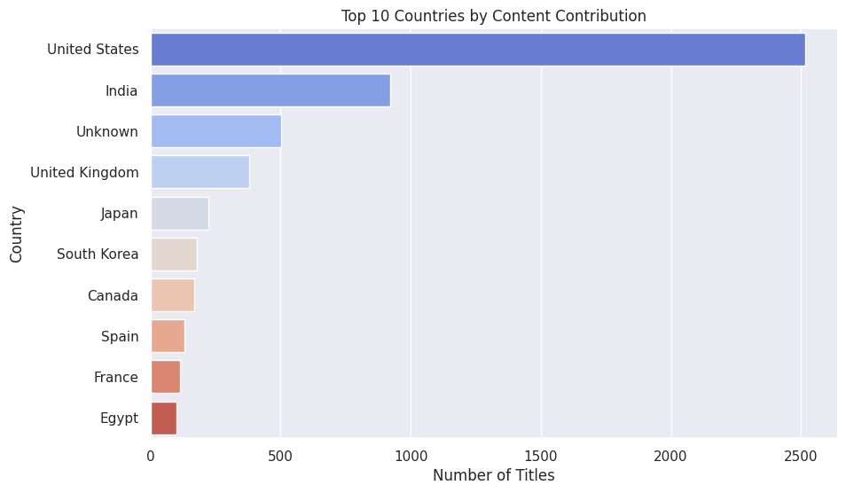
RESULTS1
[Add screen shots of your code or Chart(s) ]

Slide 7
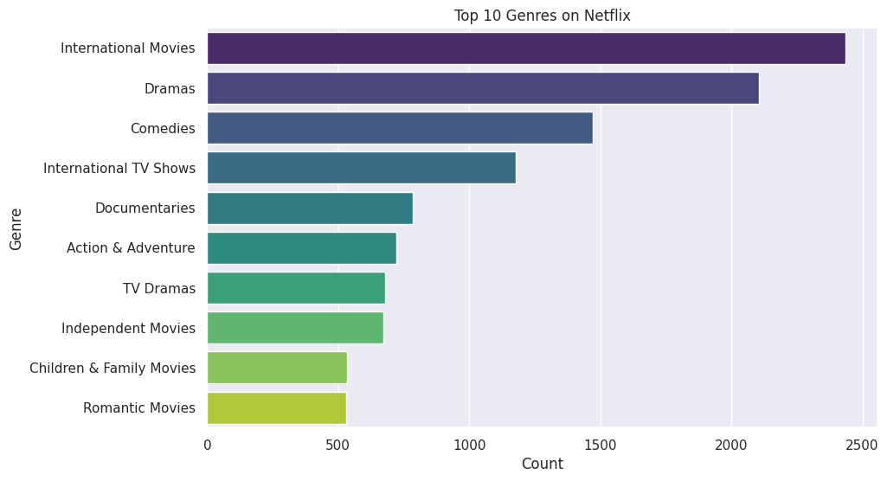
RESULTS2
[Add screen shots of your code or Chart(s) ]

Slide 8
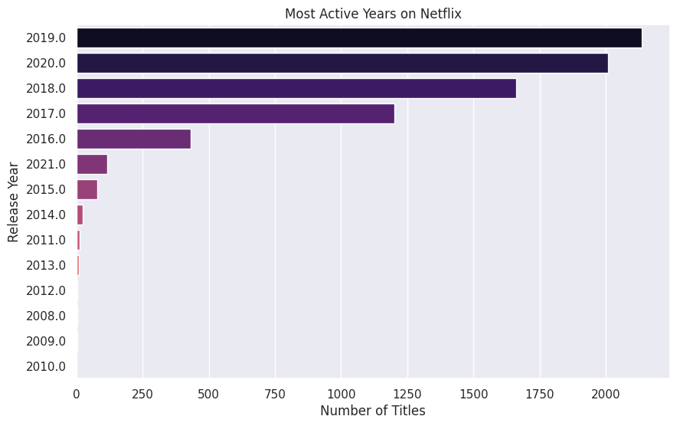
RESULTS3
[Add screen shots of your code or Chart(s) ]

Slide 9
GitHub repository
VOIS_AICTE_Oct2025_MajorProject_AbuObaida

Slide 10

Getting started with Basics of Python Certificate
[Paste your Certificate Here]

Slide 11

Data Visualization Certificate
[Paste your Certificate Here]

Slide 12
Thank you
.
.

